Slide 1


Disruptive Technologies in Medicine
Image courtesy of Enterprise Garage Consultancy
The Dawn of Virtual Reality and 3-D Printing in the Field of Medicine Revolutionizes the Science of Healing.

Slide 2

Richard Givens CISS 493 December, 2016
Bachelor’s of Science in Computer Information Systems and Management Information Systems
Product Manager – VisionTek Products, LLC
Technical Services Manager- VisionTek Products, LLC (2014 – July 2016)
Independent Consultant (2007 – Present)
“I will either find a way, or make one,” (Hannibal Barca)

Slide 3
What is a disruptive technology?
A method, technology, or technique which causes an upheaval throughout the the traditional foundations in one or more key areas of society, medicine, science, political affairs or military operations.
Often supplant previous traditional methods, or augment them in such a way as to fundamentally change their pace or direction.
Examples include Nuclear Fission, Steam Power, early Stone Tools.

Slide 4
What disruptive technologies are changing medicine today?
Virtual Reality, and its subsequent innovations.
“an artificial environment which is experienced through sensory stimuli (as sights and sounds) provided by a computer and in which one's actions partially determine what happens in the environment,” (Mirriam-Webster).
Traditional Virtual Reality
Augmented Reality
Mixed Reality
3D – Printing
“The making of parts and products using a computer-driven, additive process, one layer at a time,” (PC Magazine Encyclopedia).
Biologically stable and neutral implants, such as stints.
Prosthetic limbs
Eventual cybernetic replacement and augmentation
Inevitability of biological 3D Printing, replacement and augmentation.

Slide 5

The march to a virtual world:
Image courtesy of 3DStereo.com
1838: Charles Whetstone creates the Stereoscope, a device for viewing left and right eye images, concurrently, creating a three dimensional illusion of depth.
1932: Aldous Huxley’s “Brave New World” is published, in which characters attend “the feelies,” a sensory interactive form of entertainment offering real time immersion.
1939: William Gruber creates the View-Master, a popular children’s toy for generations.
1960s: construction of a massive advanced RADAR net covering North America, offering unprecedented data and graphical interaction.
1960 – 2012: Virtual Reality is largely relegated to the realm of science fiction and entertainment.
2012: Luckey Palmer founds Oculus.
2014: Oculus is acquired by Facebook for approximately two billion dollars.

Slide 6
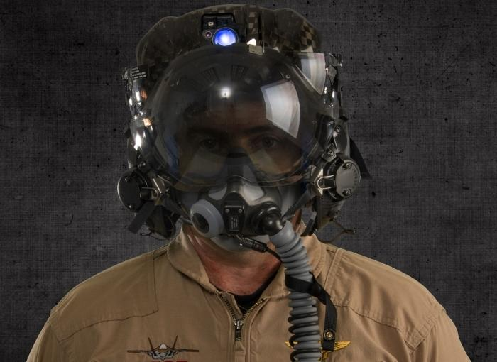
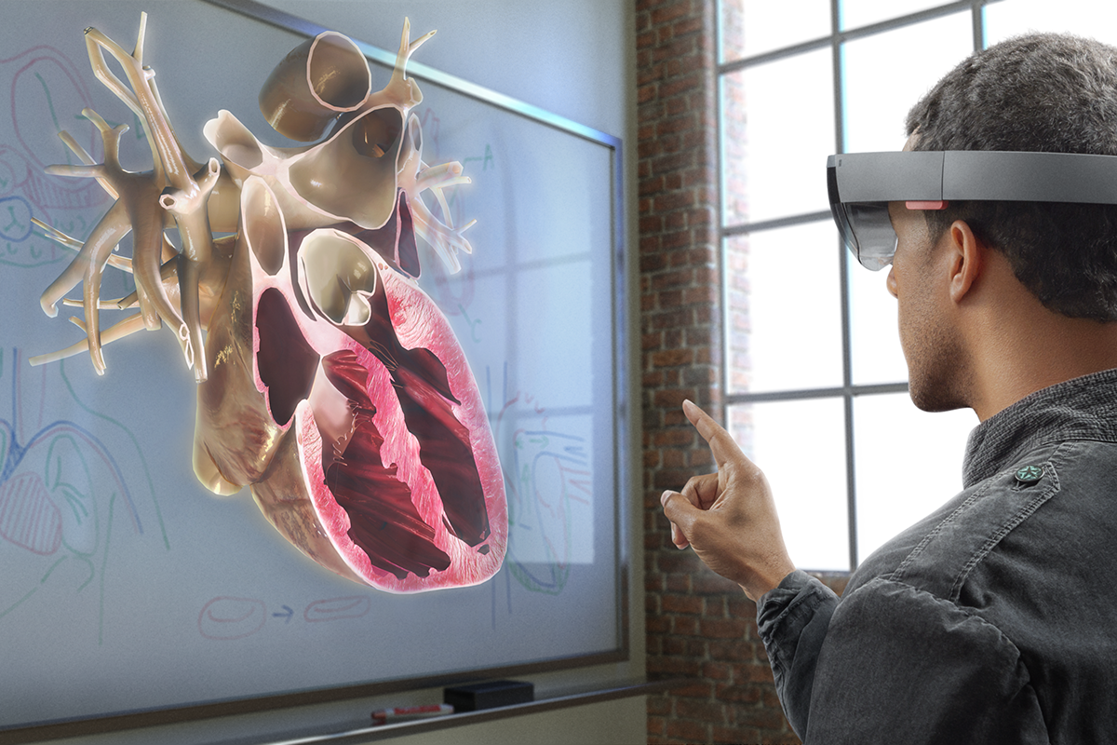
Children of Virtual Reality: Augmented and Mixed Reality
Images courtesy of www.F35.com and the Windows blog
Augmented Reality
Semi inclusive of the physical world, often superimposing graphical display in the user’s field of vision either on a mobile display or a device similar to a headset.
Mixed Reality
Fully inclusive of the outside environment, creating new visual elements which incorporate seamlessly in the form of a hologram, which one or more individuals may interact with.

Slide 7
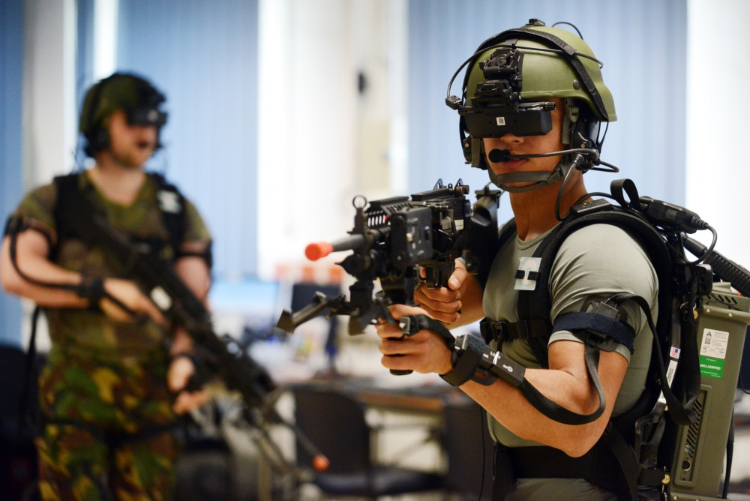
Healing our Warriors: Virtual Reality Treatment for PTSD
Image courtesy of the Defense Video Imagery Distribution System (DVIDS).
1997 Researchers begin using the Virtual Vietnam VR Scenario to treat Veterans of the Vietnam War for Post Traumatic Stress Disorder.
Virtual Immersion, a form of desensitizing Veterans to triggers associated with combat stress, by exposing them to situations in a safe, clinical setting.
Gamification of common social stimuli; simulations of crowded public places, which must be navigated using calm movements and controlled breathing.
Positive feedback loops using the natural competitive tendencies of military veterans, coupled with modern society’s fascination with digital interaction.

Slide 8
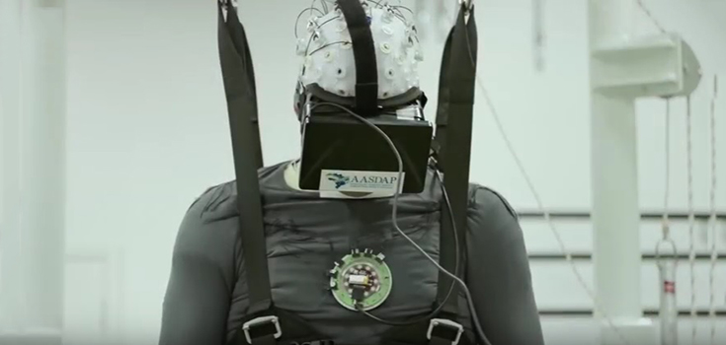
To run again, you must first learn to crawl again.
Image courtesy of Natural Society
2016: Researchers conclude a study using Virtual Reality in the treatment of patients suffering from complete paralysis
Several patients, including one paralyzed for 13 years, received an upgraded prognosis from complete paralysis, to partial paralysis after regaining some mobility.

Slide 9
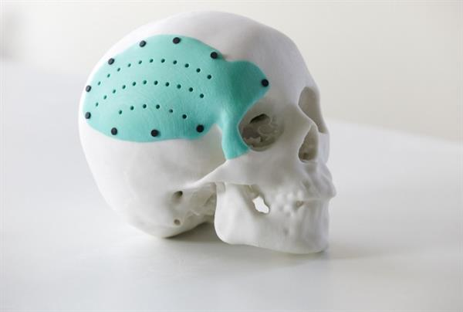
Medical 3D-Printing
2012: Surgeons at the University of Michigan’s C.S. Mott Children’s Hospital successfully implant a 3D-Printed stint, constructed of a biocompatible polymer, in a three month old baby suffering from a periodically collapsing airway. The patient was reportedly healthy a year later.

Slide 10
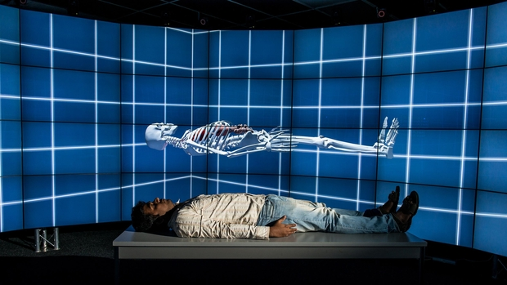
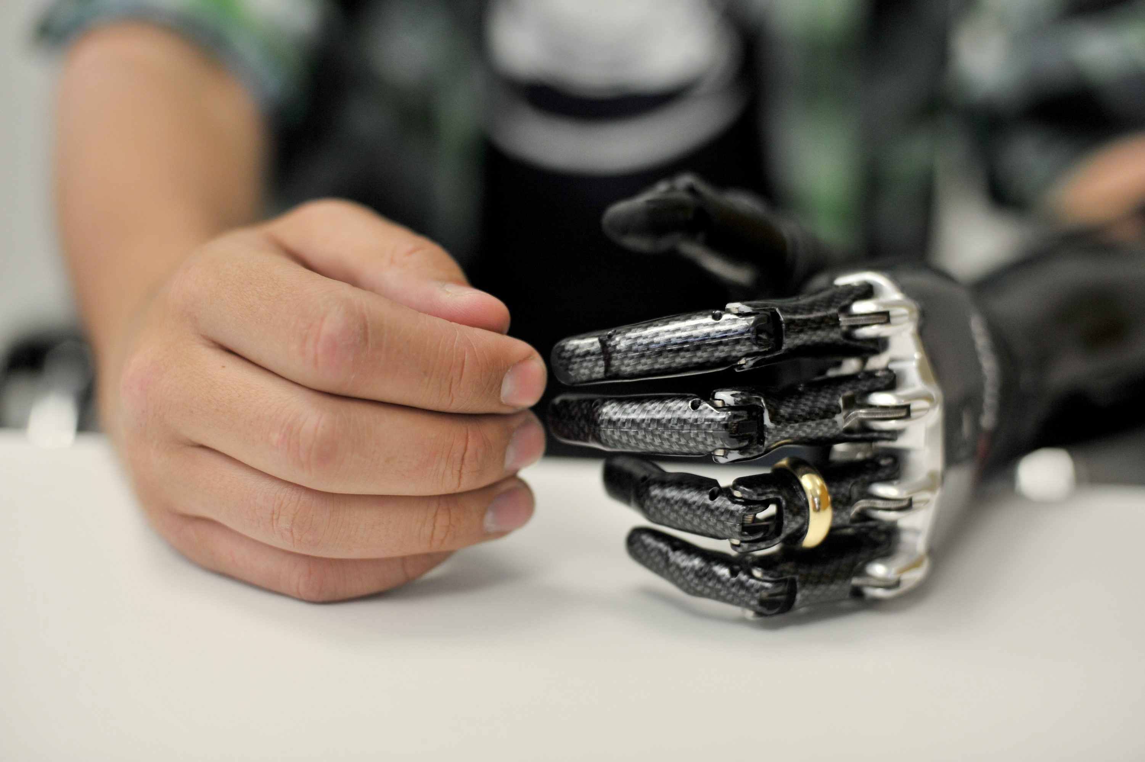
Now, and tomorrow:
Interactive patient modeling and simulation.
Surgeons practice their skills on Virtual or Holographic Simulations, or using physical 3D printed replications of organs.
Real Time collaboration across vast distances.
Individually tailored prosthetics.
Approximation of human touch and appearance.
Interactive therapy which reduces recovery time and increases quality of life.
Semi automation of surgical techniques.
Custom modeled, easy to replace surgical tools and instruments.
Correction of birth defects, and reversal of debilitating conditions previously thought unchangeable.
Eventual augmentation of the Human body.

Slide 11
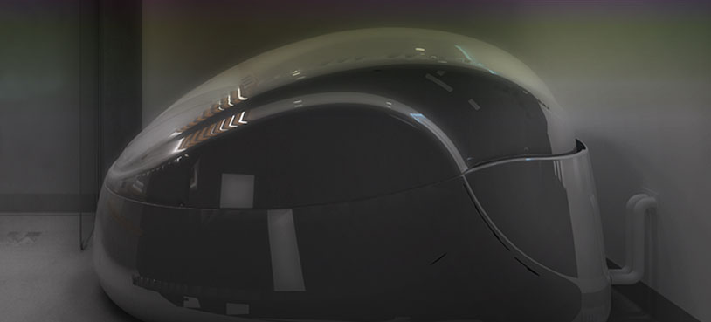
The dangers of what could be:
Image courtesy of liftfloats.com
A new status of “haves” and “have nots.”
Intellectual property and design theft.
Augmentation by personal choice and economic status, rather than medical necessity.
Misappropriation of medical research for military purposes.
Addiction to simulation, and isolation from the physical world.
The ultimate question: What makes a human?

Slide 12

The final word:
Image courtesy of The Huffington Post
The pace of technological innovation is drawing these two technologies closer to one another daily; it is an inevitability that they will merge into an amalgamation of revolutionary ideas. Virtual Reality and 3D-Printing are on the cusp of widespread adoption, and already causing a revolution of new techniques and challenges; together, they will revolutionize medical science.

Slide 13
Works Cited
Huxley, Aldous. Brave New World. NY, NY: Harper Perennial Modern Classics, 2006. Print.
Carson, Erin. “10 Ways Virtual Reality Is Revolutionizing Medicine and Healthcare - TechRepublic.” TechRepublic, 25 Oct. 2016, www.techrepublic.com/article/10-ways-virtual-reality-is-revolutionizing-medicine-and-healthcare/.
“Discover Virtual Reality in HealthCare,” director. Advanced Micro Devices, INC, 29 Apr. 2016, www.youtube.com/watch?v=jvbh-sgpyak.
Groopman, Jerome. “Print Thyself.” PRINT THYSELF, The New Yorker, 17 Nov. 2014, www.newyorker.com/magazine/2014/11/24/print-thyself.
Hansen, Tonie. “Three Companies Change Healthcare with Virtual Reality | NVIDIA Blog.” The Official NVIDIA Blog, Nvidia Corporation, 8 July 2016, blogs.nvidia.com/blog/2016/07/08/medical-virtual-reality/.
"History of Virtual Reality - Virtual Reality." Virtual Reality. N.p., 10 Jan. 2016. Web. 11 Dec. 2016. http://www.vrs.org.uk/virtual-reality/history.html.
“Immersive Healing.” Immersive Healing VR, Advanced Micro Devices, INC, www.amd.com/en-us/who-we-are/corporate-responsibility/technology/vr-immersive-healing.
Atherton, Kelsey D. "3D-Printed Gun Files Aren't Free Speech, Court Rules." Popular Science. N.p., 22 Sept. 2016. Web. 11 Dec. 2016. http://www.popsci.com/3d-printed-guns-not-free-speech-court-rules.
Khanina, Samiha. "PARAPLEGICS TAKE A STEP TO REGAIN MOVEMENT." N.p., 12 Aug. 2016. Web. https://today.duke.edu/2016/08/paraplegics-take-step-regain-movement.
Kumparak, Greg. "A Brief History of Oculus." TechCrunch. N.p., 26 Mar. 2014. Web. 11 Dec. 2016. https://techcrunch.com/2014/03/26/a-brief-history-of-oculus/.
Leadem, Rose. “10 Amazing Uses of Virtual Reality.” 10 Amazing Uses of Virtual Reality, Entrepreneur Magazine, www.entrepreneur.com/slideshow/281073#0.
Leadem, Rose. “10 Incredible Uses of Virtual Reality.” Fortune, Fortune 500 Magazine, 7 Sept. 2016, www.fortune.com/2016/09/08/virtual-reality-vr-industries-application-examples/.
Leckart, By Steven. “How 3-D Printing Body Parts Will Revolutionize Medicine.” HOW 3-D PRINTING BODY PARTS WILL REVOLUTIONIZE MEDICINE, Popular Science, 6 Aug. 2013, www.popsci.com/science/article/2013-07/how-3-d-printing-body-parts-will-revolutionize-medicine.
Malik, Om. "Pokémon Go Will Make You Crave Augmented Reality." The New Yorker. N.p., 13 July 2016. Web. 11 Dec. 2016. http://www.newyorker.com/tech/elements/pokemon-go-will-make-you-crave-augmented-reality.
McMenamin, Paul G et al. “The Production of Anatomical Teaching Resources Using Three-Dimensional (3D) Printing Technology.” The Production of Anatomical Teaching Resources Using Three-Dimensional (3D) Printing Technology, Anatomical Sciences Education, 27 June 2014, www.onlinelibrary.wiley.com/doi/10.1002/ase.1475/full.

Slide 14
Works Cited
Michalski, MD Mark H. “3D Printing in Medicine.” The Shape of Things to Come, The JAMA Network, 3 Dec. 2014, www.jamanetwork.com/journals/jama/article-abstract/1983687.
"Microsoft HoloLens." Microsoft HoloLens. N.p., n.d. Web. 11 Dec. 2016. https://www.microsoft.com/microsoft-hololens/en-us/why-hololens.
Mizokami, Kyle. "The F-35's $400,000 Third-Generation "Magic" Helmet Is Here." Popular Mechanics. N.p., 04 Mar. 2016. Web. 11 Dec. 2016. http://www.popularmechanics.com/military/weapons/news/a19764/the-f-35s-third-generation-magic-helmet-is-here/.
National Institutes of Health. U.S. Department of Health and Human Services, n.d. Web. 11 Dec. 2016. https://www.nhlbi.nih.gov/health/health-topics/topics/tah
"Project Overview." Project Overview | Antikythera Mechanism Research Project. N.p., n.d. Web. 11 Dec. 2016. http://www.antikythera-mechanism.gr/project/overview.
Roy. M. (Ed.). NATO Advanced Research Workshop on Novel Approaches to the Diagnosis and Treatment of Posttraumatic Stress Disorder. IOS Press, Washington D.C., 235-250.
Royte, Elizabeth. “What Lies Ahead for 3-D Printing?” What Lies Ahead for 3-D Printing? Smithsonian, May 2013, www.smithsonianmag.com/science-nature/what-lies-ahead-for-3-d-printing-37498558/?no-ist.
Schubert, Carl, and Mark C van Langeveld. “Carl Schubert.” Innovations in 3D Printing: a 3D Overview from Optics to Organs, British Jourof Ophthalmology, 28 Nov. 2013, www.bjo.bmj.com/content/early/2013/11/28/bjophthalmol-2013-304446.short.
Tian, Jaden. “THE REALITY OF VIRTUAL REALITY IN MEDICINE.” THE REALITY OF VIRTUAL REALITY IN MEDICINE, Washington University Review of Health, 31 Oct. 2016, www.frontiersmag.wustl.edu/2016/10/31/the-reality-of-virtual-reality-in-medicine/.
Timeline Highlights." Welcome | Timeline of Computer History | Computer History Museum. N.p., n.d. Web. 11 Dec. 2016. http://www.computerhistory.org/timeline.
"VIRTUAL REALITY - History." VIRTUAL REALITY - History. N.p., n.d. Web. 11 Dec. 2016. http://archive.ncsa.illinois.edu/Cyberia/VETopLevels/VR.History.html.
“Virtual Reality with AMD LiquidVR™ Technology.” LiquidVR™, Advanced Micro Devices, INC, www.amd.com/en-us/innovations/software-technologies/technologies-gaming/vr?utm_campaign=www.amd.com_liquidvr&utm_medium=redirect&utm_source=301.
Yang, Dong Hyun et al. “Myocardial 3-Dimensional Printing for Septal Myectomy Guidance in a Patient with Obstructive Hypertrophic Cardiomyopathy.” Myocardial 3-Dimensional Printing for Septal Myectomy Guidance in a Patient with Obstructive Hypertrophic Cardiomyopathy, American Heart Association, 27 July 2015, www.circ.ahajournals.org/content/132/4/300.full.

